Slide 1

Artificial Intelligence (CS-2002)
Informed Search Strategies

Slide 2
Objectives
Heuristics
Greedy Best first Search
A*

Slide 3
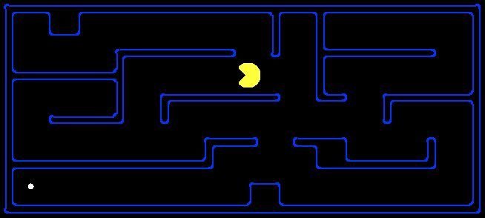
Search Heuristics
The algorithms have additional information along with the goal state, which helps in more efficient searching. This information is obtained by something called a heuristic.
A heuristic is:
A function that estimates how close a state is to a goal
Designed for a particular search problem
Examples: Manhattan distance, Euclidean distance for pathing
10
5
11.2

Slide 4
Greedy Best First Search
In greedy search, we expand the node closest to the goal node. The “closeness” is estimated by a heuristic h(x) .
Heuristic: A heuristic h is defined as- h(x) = Estimate of distance of node x from the goal node. Lower the value of h(x), closer is the node from the goal.
Strategy: Expand the node closest to the goal state, i.e. expand the node with lower h value.

Slide 5
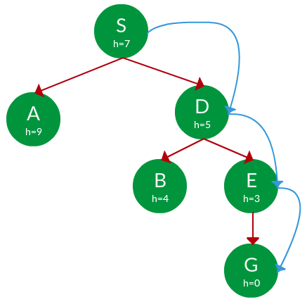
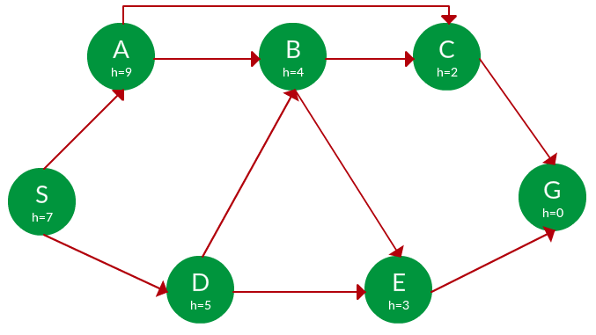
Example:
Find the path from S to G using greedy search.
Solution
Starting from S, we can traverse to A(h=9) or D(h=5). We choose D, as it has the lower heuristic cost. Now from D, we can move to B(h=4) or E(h=3). We choose E with lower heuristic cost. Finally, from E, we go to G(h=0).
Path:
S -> D -> E -> G

Slide 6
Travel Sales Man Problem using Greedy Search
h(x)

Slide 7
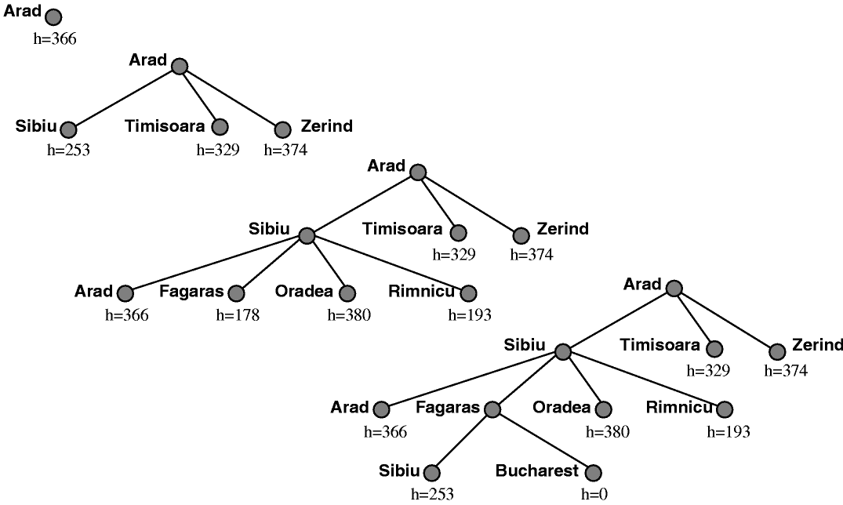
Greedy Search……
What can go wrong?
Not optimal

Slide 8
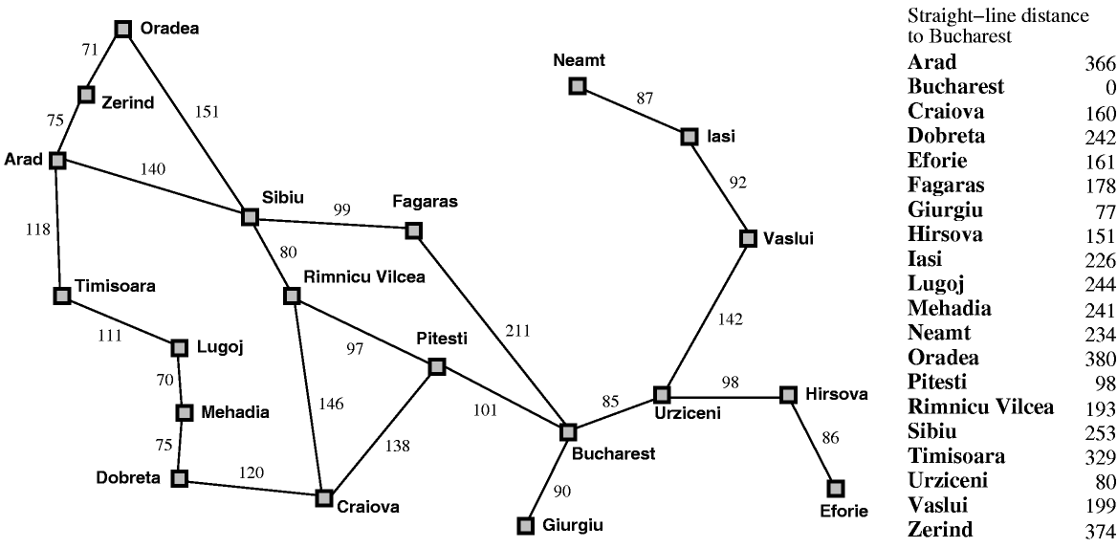
Greedy search leads to a minimal cost search because no node off the solution path is expanded. However, it does not find the optimal path: the path it found via Sibiu and Fagaras to Bucharest is 13 miles longer than the path through Pimnicu Vilcea and Pitesti.
Red Path (GBF)=431
Green Path (UCS)= 418

Slide 9

A* Search
A* Search, combines the strengths of uniform-cost search and greedy search. In this search, the heuristic is the summation of the cost in UCS, denoted by g(x), and the cost in greedy search, denoted by h(x). The summed cost is denoted by f(x).
Heuristic: The following points should be noted w.r.t heuristics in A* search.
A* Search orders by the sum: F(N) = G(N) + H(N)
Uniform-cost orders by path cost,
or backward cost g(n)
Greedy orders by goal proximity,
or forward cost h(n)

Slide 10
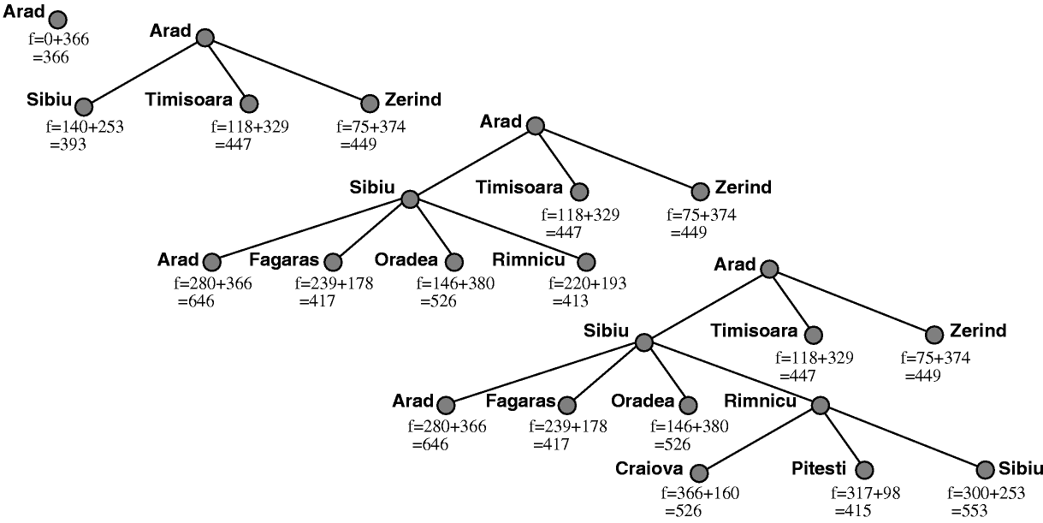
A* Search

Slide 11
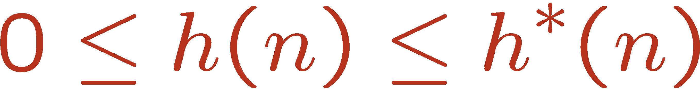
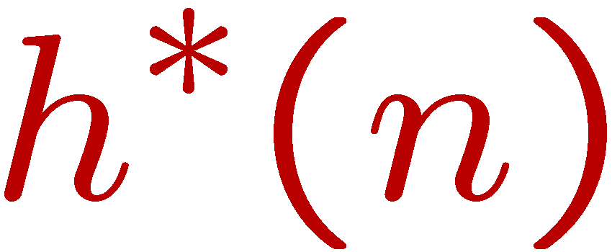
Admissible Heuristics
A heuristic h is admissible (optimistic) if:
where is the true cost to a nearest goal

Slide 12
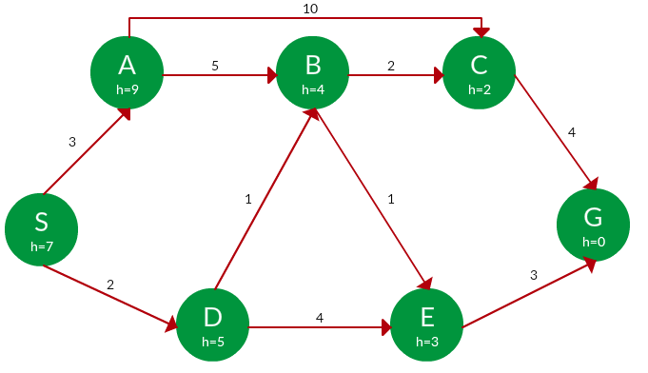

A* Search
PATH | H(X) | G(X) | F(X)
S | 7 | 0 | 7
S -> A | 9 | 3 | 12
S -> D | 5 | 2 | 7
S -> D -> B | 4 | 2 + 1 = 3 | 7
S -> D -> E | 3 | 2 + 4 = 6 | 9
S -> D -> B -> C | 2 | 3 + 2 = 5 | 7
S -> D -> B -> E | 3 | 3 + 1 = 4 | 7
S -> D -> B -> C -> G | 0 | 5 + 4 = 9 | 9
S -> D -> B -> E -> G | 0 | 4 + 3 = 7 | 7
Path: S -> D -> B -> E -> G
Cost:7

Slide 13
Consistency of Heuristics
Main idea: estimated heuristic costs ≤ actual costs
Admissibility: heuristic cost ≤ actual cost to goal
h(A) ≤ actual cost from A to G
Consistency: heuristic “arc” cost ≤ actual cost for each arc
h(A) – h(C) ≤ cost(A to C)

Slide 14
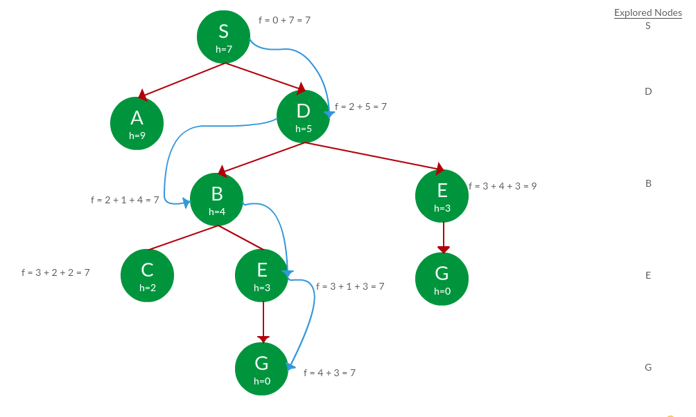
A* Search
Path: S -> D -> B -> C -> E -> G Cost: 7

